Slide 1


Preparation for Adulthood
Strengthening the connection between Careers and SEND
GCC Preparation for Adulthood Outcomes Lead Sarah Smith
GCC Preparation for Adulthood Support Team Lead Tim Griffiths
Education, Planning and Infrastructure

Slide 2
Agenda
02. Post 16 Toolkit with QR Code
03. Introduction – what has worked well
04. Resources developed
05. Impact Statements from PfA training
06. Key messages
07. Contact details

Slide 3
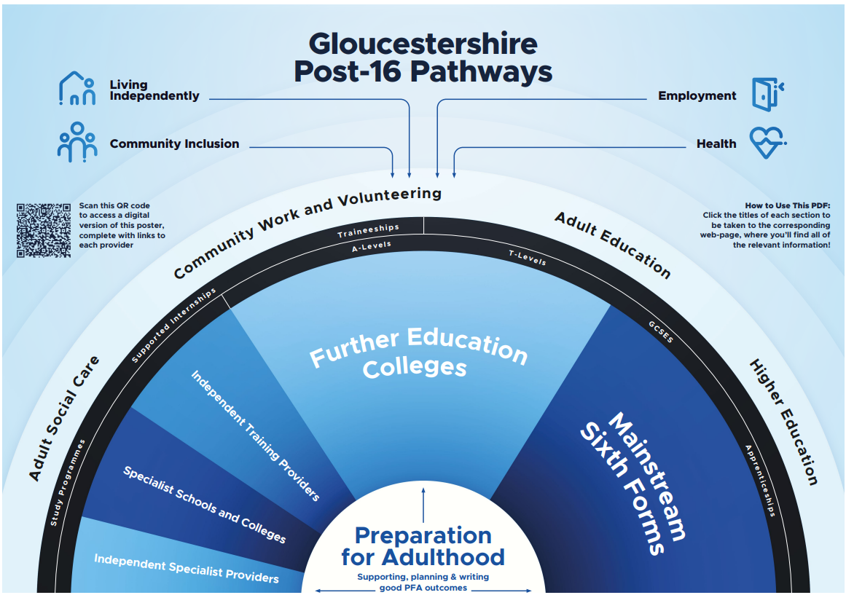
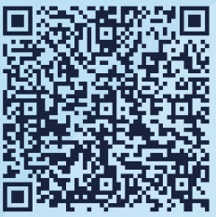


Slide 4
Introduction – what has worked well
Our shared vision is for everyone working across education, health and social care in Gloucestershire to have a standardised and consistent approach to Preparation for Adulthood.
Targeting YP, families, carers and professionals to think about PfA from year 6 ready for year 9.
The PfA team have increased the provision of their commissioned services after successful trials in two mainstream schools and are now taking expressions of interest from educational settings across the county.
We have delivered our PfA training to over 500 professionals across the services.
Settings approaching the PFA team to assist with guidance around outcomes.
PFA Support Team have successfully trailed bespoke PFA Support on a 1:1 basis to exceptional provision, have completed a full academic year's support to a YP on a S117 as part of a multi-agency collective with Education, Health and Social Care, expanded reach with commissioned support across mainstream schools.
We are starting to see impact in improved PfA outcomes.
Working closely with GPCF we are attending SEND parents’ coffee mornings across schools in the county to engage with SEND parents and carers. We delivered our annual SEND PFA Events and consistently updating PFA pages on the local offer.
After redesigning the programme based on learning from our pilot year, we are now delivering a flexible hybrid Preparation for Adulthood programme in schools, local community and if accessible the Skillzone village

Slide 5

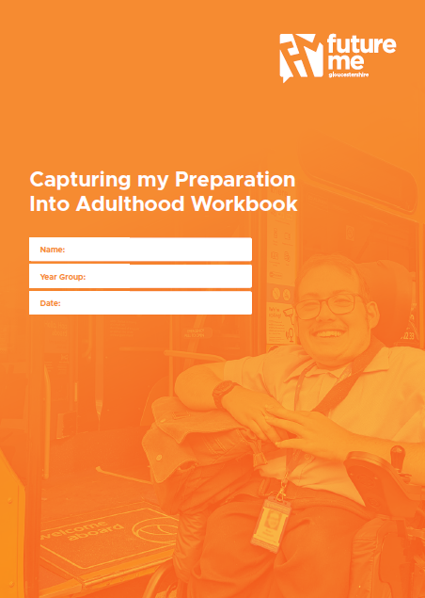
This booklet is being redesigned – updated version available from Springtime 2026

Slide 6
I enjoyed the beginning of the content and the discussions guided by the trainers. I have more insight now into what the PfA concept is.
Anonymous feedback
I have a better understanding of the background of PFA, the key principles that underscore it and what the common pitfalls are when writing outcomes.
Anonymous feedback
The Virtual School were delighted to engage in training about ‘ Preparation For Adulthood’ ( PFA) this term. The team recognised the training had value for the young people in the care system and other vulnerable young people as they start to reflect and plan the next steps towards adult life. .
If you haven’t had the opportunity to look at the PFA materials or if you get the chance to have the training so that you can support young people you work with, we recommend it.
Jane Featherstone, Head Teacher, Virtual School
The workbook was helpful in identifying the four pathways and I liked that it’s a booklet as I can take it away with me for future reference.
Anonymous feedback
I now feel more able to turn a young person's aspirations into an outcome by following the steps.
Anonymous feedback

Slide 7
Key messages
Sustainability of our work, all our work is sustainable, teaching staff to deliver PFA and to generate quality conversations with their CYP
Whole school approach, moving away from being reactive supporting settings to become more inclusive not just focusing on CYP with an EHCP
Savings in home to school transport including invisible saving SEND POUND ££
Expanding our PFA team
Working with Parents and Carers, encourage and advise parents and carers on how to support their CYP PFA journey, offer strategies to help them build their YP confidence and resilience in the community and with independence
Improve outcomes which in turn increase better opportunities for our CYP with SEND
Supporting YP in PFA to prevent long-term disengagement
Whole service PFA presentations to our wider colleagues to include including STEPS, GHLL AND EP’S
Notes:
Note – whole school approach – working 1:1 with YP, training staff, engaging with groups of students, engaging with Parents and families.

Slide 8
If you would like further information or support around PfA, please contact;
preparationforadulthood@gloucestershire.gov.uk
Tim Griffiths – tim.griffiths@gloucestershire.gov.uk
Sarah Smith – sarah.smith3@gloucestershire.gov.uk

