Slide 1
Virtual Work Experience: Strengthening Curriculum, Careers & Confidence
Charlie Presley, Careers Engagement & Outreach Lead
22nd January 2026

Slide 2
Why we designed this Programme
Support Modern Work Experience
Provides 25 hours of structured, meaningful experience
Meets national guidance
Complement, not replace, face‑to‑face
We continue to offer face‑to‑face opportunities
Reduce pressure on teams
High demand for placements
Virtual model protects clinical capacity
Build confidence & real‑world understanding
Prepares students for real NHS & Social Care environments
Gives practical insight into roles, expectations, and behaviours

Slide 3
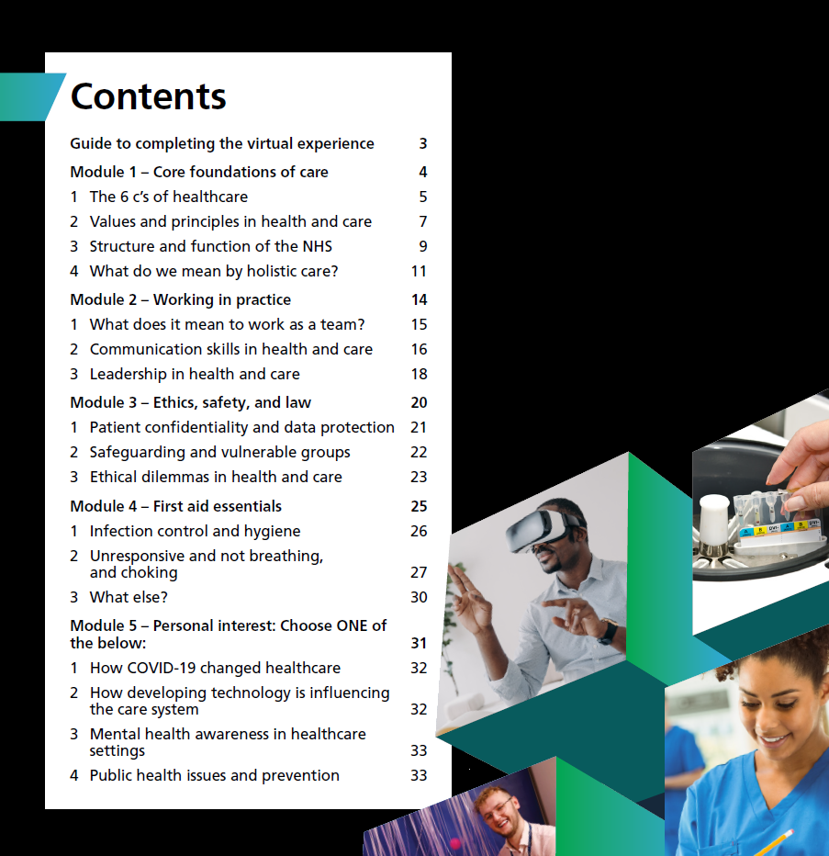
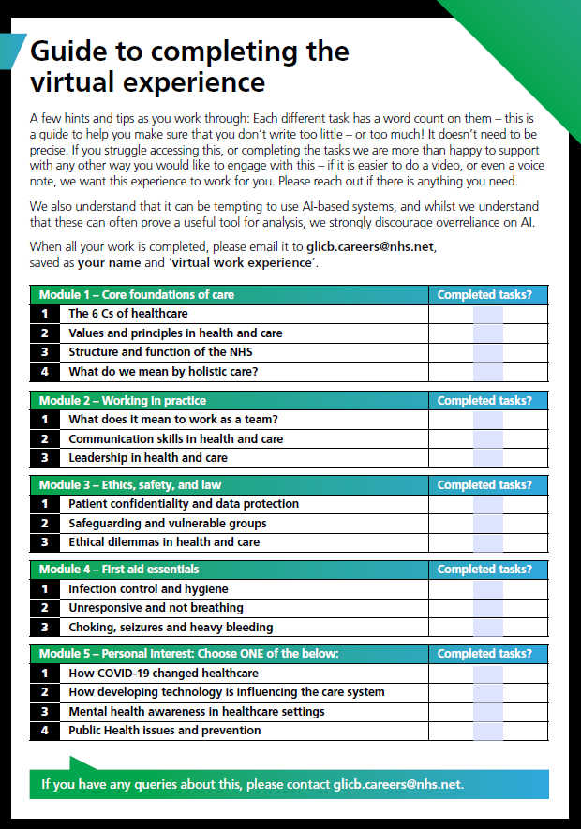

Slide 4
How the Virtual Work Experience Programme Supports KS4 Health & Social Care
Aligned with KS4 H&SC curriculum: Reinforces care values, communication, safeguarding, ethics, teamwork, service provision, and health & wellbeing
Mapped directly to GCSE/BTEC content: Each module links to assessed topics such as person‑centred care, legislation, multi‑agency working, and health promotion
Notes:
The programme is 95% aligned with GCSE and BTEC Health & Social Care, with only small optional enhancements needed to make the mapping completely comprehensive. When I say the programme is aligned with the KS4 Health & Social Care curriculum, I’m talking about the big concepts students learn at this level, things like care values, communication, safeguarding, ethics, teamwork, service provision, and health and wellbeing. These are the foundations of the subject, and our programme reinforces all of them through real NHS examples.
When I say the programme is mapped directly to GCSE and BTEC content, I’m going a step further. This means each module links to the specific topics students are actually assessed on, person‑centred care, legislation, multi‑agency working, health promotion, and so on. So it’s not just broadly supportive; it connects directly to the exam specifications.
In short, one statement is about supporting the overall curriculum, and the other is about matching the exact content students need for their qualifications

Slide 5
Cross‑Curricular Links
Strengthens learning across multiple subjects:
- Science: infection, disease, body systems
English: communication, reflective writing
PSHE: careers, wellbeing, personal development
Digital Skills: data protection, digital literacy
Citizenship: public services & NHS structure
Post‑16 Strengthens progression into:
T‑Levels (Health, Science, Digital, Business & Admin)
BTEC/CACHE Health & Social Care
UCAS & apprenticeship applications
Industry‑placement readiness

Slide 6

Skills Development (Universal Skills Framework)
Virtual Wex programme: Essential Skills Framework Match:
- Communication Speaking, listening
- Teamwork Teamwork
- Problem‑solving Problem- solving
- Leadership Leadership
- Self‑management Staying Positive, Aiming High
- Digital literacy Digital skills
Confidence & resilience Staying Positive, Self‑Belief
These are exactly the skills the NHS & SC consistently highlight as essential for entry‑level roles, apprenticeships, and progression

Slide 7

Gatsby Benchmarks
The programme gives schools strong evidence for:
- Benchmark 2: Labour market information
- Benchmark 4: Linking curriculum to careers
- Benchmark 5: Encounters with employers
- Benchmark 6: Experiences of workplaces
- Benchmark 7: Encounters with further & higher education
This directly supports Ofsted’s Personal Development & Wellbeing Evaluation

Slide 8
Benefits for Students
- Clear understanding of One Gloucestershire & local NHS trusts
- Insight into how the Integrated Care System operates
- Stronger UCAS, college & apprenticeship applications
- Informed career decision‑making
- Pathway to face‑to‑face placements
25 hours of meaningful work‑related learning
Certificate of completion and added to talent pool
Students gain real insight, not just theory.
Notes:
Students who complete the KS4 Virtual Work Experience gain a range of meaningful advantages that directly support their education, career planning, and future progression:
1. Strong Understanding of One Gloucestershire
Students develop a clear picture of how the Integrated Care System (ICS) works locally.
They learn about the different NHS trusts, services, and pathways across Gloucestershire.
This gives them local system knowledge that most applicants don’t have.
2. Supports UCAS Applications and Personal Statements
Students can evidence real insight into NHS roles, care values, safeguarding, teamwork, and ethics.
The programme provides specific examples they can use in UCAS personal statements, interviews, and college applications.
It strengthens applications for Health & Social Care, Nursing, Medicine, Allied Health, and Social Care courses.
3. Informed Career Decision‑Making
Exposure to a wide range of roles helps students understand what different careers involve.
They gain clarity about entry routes, apprenticeships, T‑Levels, and university pathways.
This leads to more confident and informed career choices.
4. Pathway to Face‑to‑Face Work Experience
Completing the virtual programme can act as a gateway to in‑person placements.
Students who show commitment and understanding are better prepared for real‑world settings.
5. Counts Towards the New “Modern Work Experience” Requirements
The programme provides 25 hours of meaningful work‑related learning, in line with new national guidance.
Schools can use this to evidence their work‑experience offer for KS4 and KS5.
6. Builds Skills and Confidence
Students develop communication, teamwork, problem‑solving, and digital skills.
They gain confidence in understanding how the NHS works and what is expected in care settings.

Slide 9
Benefits to Schools
- Enhances curriculum delivery without adding workload
- Provides high‑quality careers evidence
- Supports Ofsted Personal Development
- Offers a consistent, scalable work‑experience solution
- Gives students access to NHS & Social Care expertise and local pathways
A ready‑made, high‑value resource that strengthens your school’s offer.

