Slide 1
National Policy Update: The Direction of Careers Leadership and Its Impact on Education
Sian Gresswell

Slide 2
The impact of the new statutory requirements for careers education

Slide 3
Revised statutory guidance for careers – May 2025
Signals Government ambition for a Work Experience Guarantee
Implementation of updated Gatsby Benchmarks – September 2025
Updated Compass Questionnaire goes live – November 2025
Expected fuller guidance on Work Experience Guarantee – Spring 2026
Recent key national updates

Slide 4

Understanding the updates to the Gatsby Benchmarks

Slide 5

The Gatsby Benchmarks

Slide 6

Understanding the updates: video

Slide 7
Five key themes underpinning the updates:
Careers at the heart of education and leadership
Inclusion and impact for each and every young person
Meaningful and varied encounters and experiences
Focusing on the use of information and data
Engagement of parents and carers
What areas do the updates focus on?

Slide 8
Continued support for all schools, special schools and colleges to have a trained Careers Leader with a focus on strategic careers planning
Commitment to updated Gatsby Benchmarks including a focus on parent & carer engagement and whole staff development
Continued commitment to quality assurance through Matrix and Quality in Careers Standard and now also Careers Impact System
Preparation for the work experience guarantee
Checklists and Summaries for Education Leaders available via CEC Resource Directory
Careers Statutory Guidance:
Update
May 2025

Slide 9
The government’s ambition for a work experience guarantee

Slide 10
Implementing 2 weeks’ worth of work experience
Our vision is that 2 weeks’ worth of work experience will be based on the following set of principles, building on the benchmark 6 definition of meaningful.
Two weeks’ worth of work experience should be broken down into:
one weeks’ worth of work experience activities in years 7 to 9
one weeks’ worth of work experience placement(s) in years 10 to 11
Experiences should be aspirational and inspirational, giving young people the opportunity to access a wide range of career opportunities, aligned to their interests and talents, local skills needs and national growth sectors. Opportunity should go beyond the horizons of their immediate friends and family.
They should be co-designed and delivered in partnership with schools and involve two-way employer-pupil interaction.”
From Statutory Guidance – 8th May 2025

Slide 11
Careers education in inspection – September 25
In gathering evidence about careers education, inspectors consider the extent to which:
Leaders ensure that all secondary-age pupils are well prepared and supported to progress in education, employment or training, including continuing in education or training until at least their 18th birthday
where relevant, there is an appropriate careers programme that meets the Gatsby Benchmarks and includes impartial advice and guidance from a qualified careers adviser, opportunities for workplace experiences, and engagement with employers, colleges, training providers and universities
secondary-age pupils have an appropriate understanding of relevant trends in local and national employment and the implications of the choices they make in relation to these
pupils with SEND develop independence, contribute to their community, make positive friendships and are supported to be as healthy as possible

Slide 12
Confident articulation of impact across new
Ofsted Evaluation areas
Evaluation Area | Questions to consider
Leadership and Governance | How well do leaders understand learners’ needs, and how has this shaped the careers provision? Has careers provision been used to address key institutional challenges?
Curriculum and teaching / Curriculum teaching and training | Is the curriculum designed to build knowledge and skills for future education, training, or employment? How does the strategic careers plan influence curriculum intent and planning? How is destination data used to shape curriculum decisions? Does the curriculum reflect local labour market needs? What support is available to help staff understand labour market information and transition pathways? How are staff supported to highlight the relevance of their subject to careers, pathways, & essential skills? How are staff supported to make links from the curriculum to careers, pathways, and essential skills?
Attendance and behaviour / Participation and Development | Does the strategic careers plan help build cultural capital, especially for disadvantaged learners and those with SEND? Does the strategic careers plan support positive attitudes to learning and improved engagement? Do employer and education encounters inspire learners and improve attendance?
Inclusion | How is data on vulnerable groups used to plan targeted careers provision? How do you ensure all learners including those absent or in alternative provision access careers provision? What evidence shows the impact of differentiated careers provision for vulnerable learners?

Slide 13
“We strongly recommend the use of the Careers Impact System which supports a quality assured, sustainable and strategic approach to careers leadership and establishes a shared and standardised language of quality improvement for careers, aligned to school and college improvement.”
Department for Education Statutory Guidance: Careers guidance and access for education and training providers May 2025

Slide 14
Framework for excellence: what “good” looks like nationally

Slide 15

Careers Impact
internal leadership reviews

Slide 16
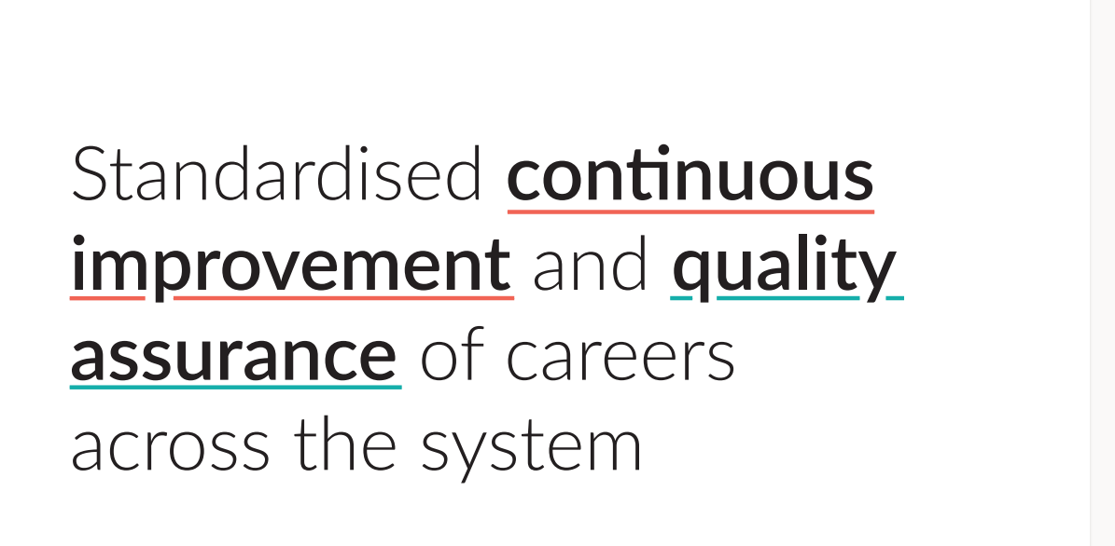

Slide 17
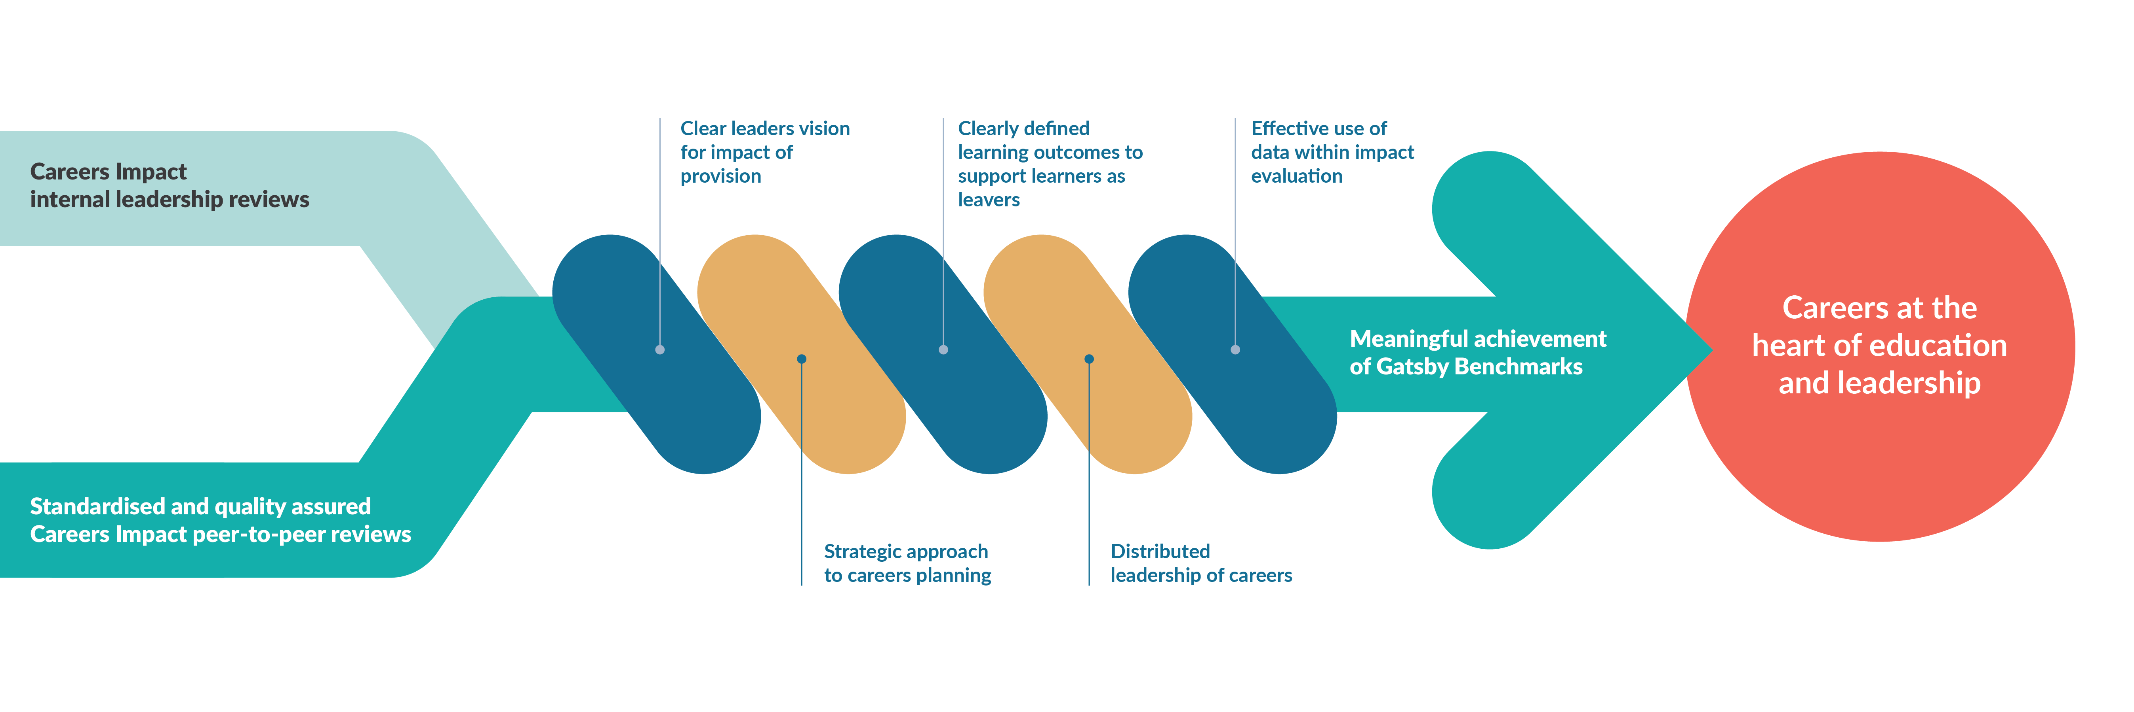
The Careers Impact Model

Slide 18
Without strategic reflection,
careers provision risks remaining fragmented, reactive, and disconnected from wider improvement efforts,
ultimately limiting its impact on learners.

Slide 19

Careers impact internal leadership and peer-to-peer reviews
Hear from education leaders and careers leaders…
Why do you recommend education and careers leaders undertake a Careers Impact internal leadership review?
What has been the value and impact of undertaking a Careers Impact internal leadership review?
How did you approach Careers Impact internal leadership review?
Why participate in a Careers Impact peer to peer review?
What has been the value and impact of participating in a Careers Impact peer to peer review?
What has been the value and impact of participating in a Careers Impact peer to peer review (Hubs)?
What did a Careers Impact peer to peer review look and feel like?

Slide 20
Delivered with equity
Quality experiences
equalex delivers an Outcomes Framework to modernise quality workplace experiences programmes
Providing clarity, setting the expectation, delivering quality

Slide 21



Workplace experiences as a progressive programme
Lower volume, higher depth
Apply & Demonstrate
Investigate & Explore
Introduce & Inspire
Higher volume, lower depth

Slide 22

equalex graduate
Knowledge
Awareness of pathways into a career in the different industries and the roles associated with those pathways
Has used the knowledge gained to help make informed decisions about their transition thinking through the range of options available to them at Post 16 and Post 18
Increased confidence around their own skill set and how this can best support them in the future workplace
Skills
Can self-advocate and articulate the sector skills they have developed to support future choices
Equipped with the skills to support them in making a successful transition
Developed skills and qualifications relevant to their chosen pathway through employer experiences and projects
Sees the relevance of skills from their curriculum learning and qualifications to their future options
Behaviours
Developed an understanding of workplace culture and how this differs across different sectors
Developed positive workplace behaviours through multiple experiences
Feels confident in making positive informed decisions regarding their future options
At the end of equalex programme;
Understands pathways
Realises own potential
Sees the relevance of curriculum to workplace
Has agency in own skills development
Has improved careers readiness scores

Slide 23
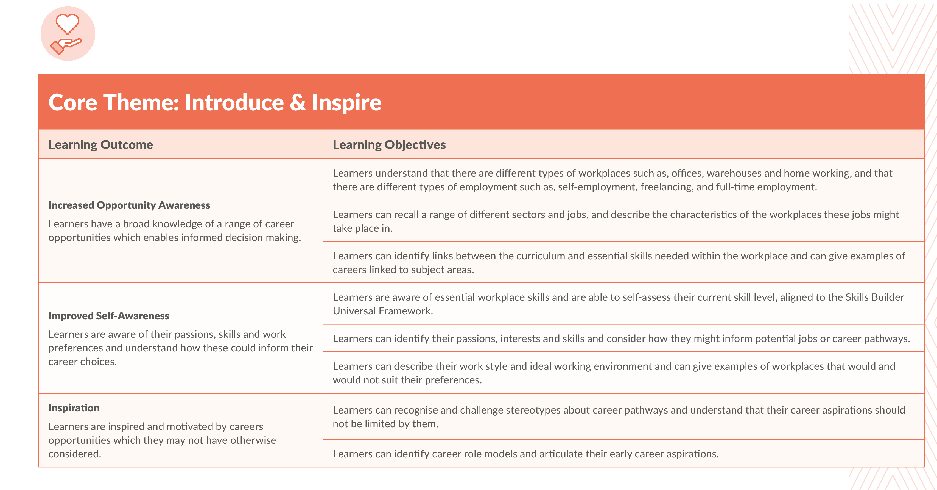
Learning Objectives

Slide 24
equalex: in action in education
Pilots and testing

Slide 25

Curriculum led
Examples include:
Redevelopment of curriculum model with careers at heart - Three Spires Trust, Next Gen KS3 curriculum model based around jobs in 2030. Workplace experiences will permeate and be mapped across the whole curriculum.
Hartlepool Aspire Trust Specialist provision – curriculum centred around enterprise skills with continuous workplace experiences interwoven throughout to meet needs including Catcote Crew for MLD learners
Greater Manchester Careers Hub is using equalex as an element of the Mbacc model around vocational and technical education pathways
Equalex tiers:
T1 – Introduce & Inspire
T2 – Investigate & Explore
T3 – Apply & Demonstrate

Slide 26
Multiple progressive example
Examples include:
Priory Federation of Academies Trust progressive model from Year 7 – 11 with focus on employer engagement through encounters and experiences which progressively builds skills throughout the 5year approach including technical education focus.
Catcote Academy is using a progressive approach with their Red pathway learners supporting them to gain multiple experiences through employer led projects incorporating a progressive skills-based model from internal to external experiences.
Equalex tiers:
T1 – Introduce & Inspire
T2 – Investigate & Explore
T3 – Apply & Demonstrate

Slide 27
Enhancement examples
Examples include:
Lift Academies Trust have several models in pilot including:
Integrating experiences of workplaces into existing careers and character curriculum ‘drop down’ days, initially at KS3
Using experiences of workplaces as part of a NEET prevention strategy for young people who persistently disengage.
Evolving ‘strive time’ (timetabled enrichment) to incorporate experiences of workplaces throughout Y7-Y10.
West Midlands Careers Hub model is supporting young people who are disadvantaged by delivering experiences specific to a small group of vulnerable learners to support aspiration raising.
COOP Academies trust model works alongside the existing curriculum to embed a progressive approach to experiences including employer enterprise challenges, encounters with FE alongside work placements.

Slide 28
Sector led example
Examples include:
Lift Academies Trust model includes curriculum-based activities across KS3 linked to growth sectors to enable traditional block placements in Yr 10 to be planned with intent and purpose linked to equalex outcomes and learner interests and aspirations
Liverpool City Region Careers Hub is working to develop and test pipelines of workplace experiences linked to industrial growth and skills needs
West Yorkshire Careers Hub is working with local delivery providers to support young people and to help schools become better commissioners of workplace experiences
Equalex tiers:
T1 – Introduce & Inspire
T2 – Investigate & Explore
T3 – Apply & Demonstrate

Slide 29
Immersive programme example
Examples include:
Working collaboratively with a convening delivery provider, employers and further education partners, KS3 or KS4 learners are briefed and choose from sector pathways prior to a week hosted at their local college or university.
During the week learners participate in group BM6 visits to multiple employers (working together to provide collaborative experiences for example Hertfordshire example), have BM7 pathway experiences delivered by providers and in their host institution and participate in BM5 employer encounters whilst in their host institution and learners work on industry focussed projects. Accompanying teachers also experience workplaces and employers resulting in longer term curriculum connections.
In one week in the calendar there is potential for a whole year group approach to meet elements of BM4,5,6,7 (*the design and structure would determine what proportion of BMs and relevant days of work experience are delivered)

Slide 30









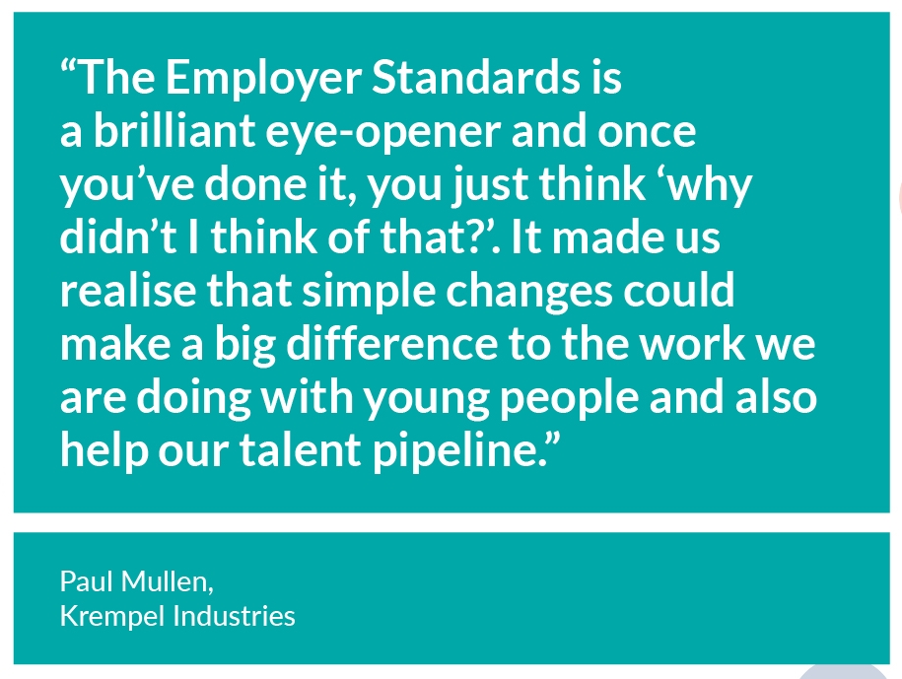
Employer Standards
for Careers Education

Slide 31

Why did we develop the Employer Standards?
Codify best practice so all businesses can learn from it
Provide a clear roadmap of what leads to positive outcomes for business AND young people
Support employers to develop and continuously improve their approach
Raise the quality of employer engagement in careers education

Slide 32

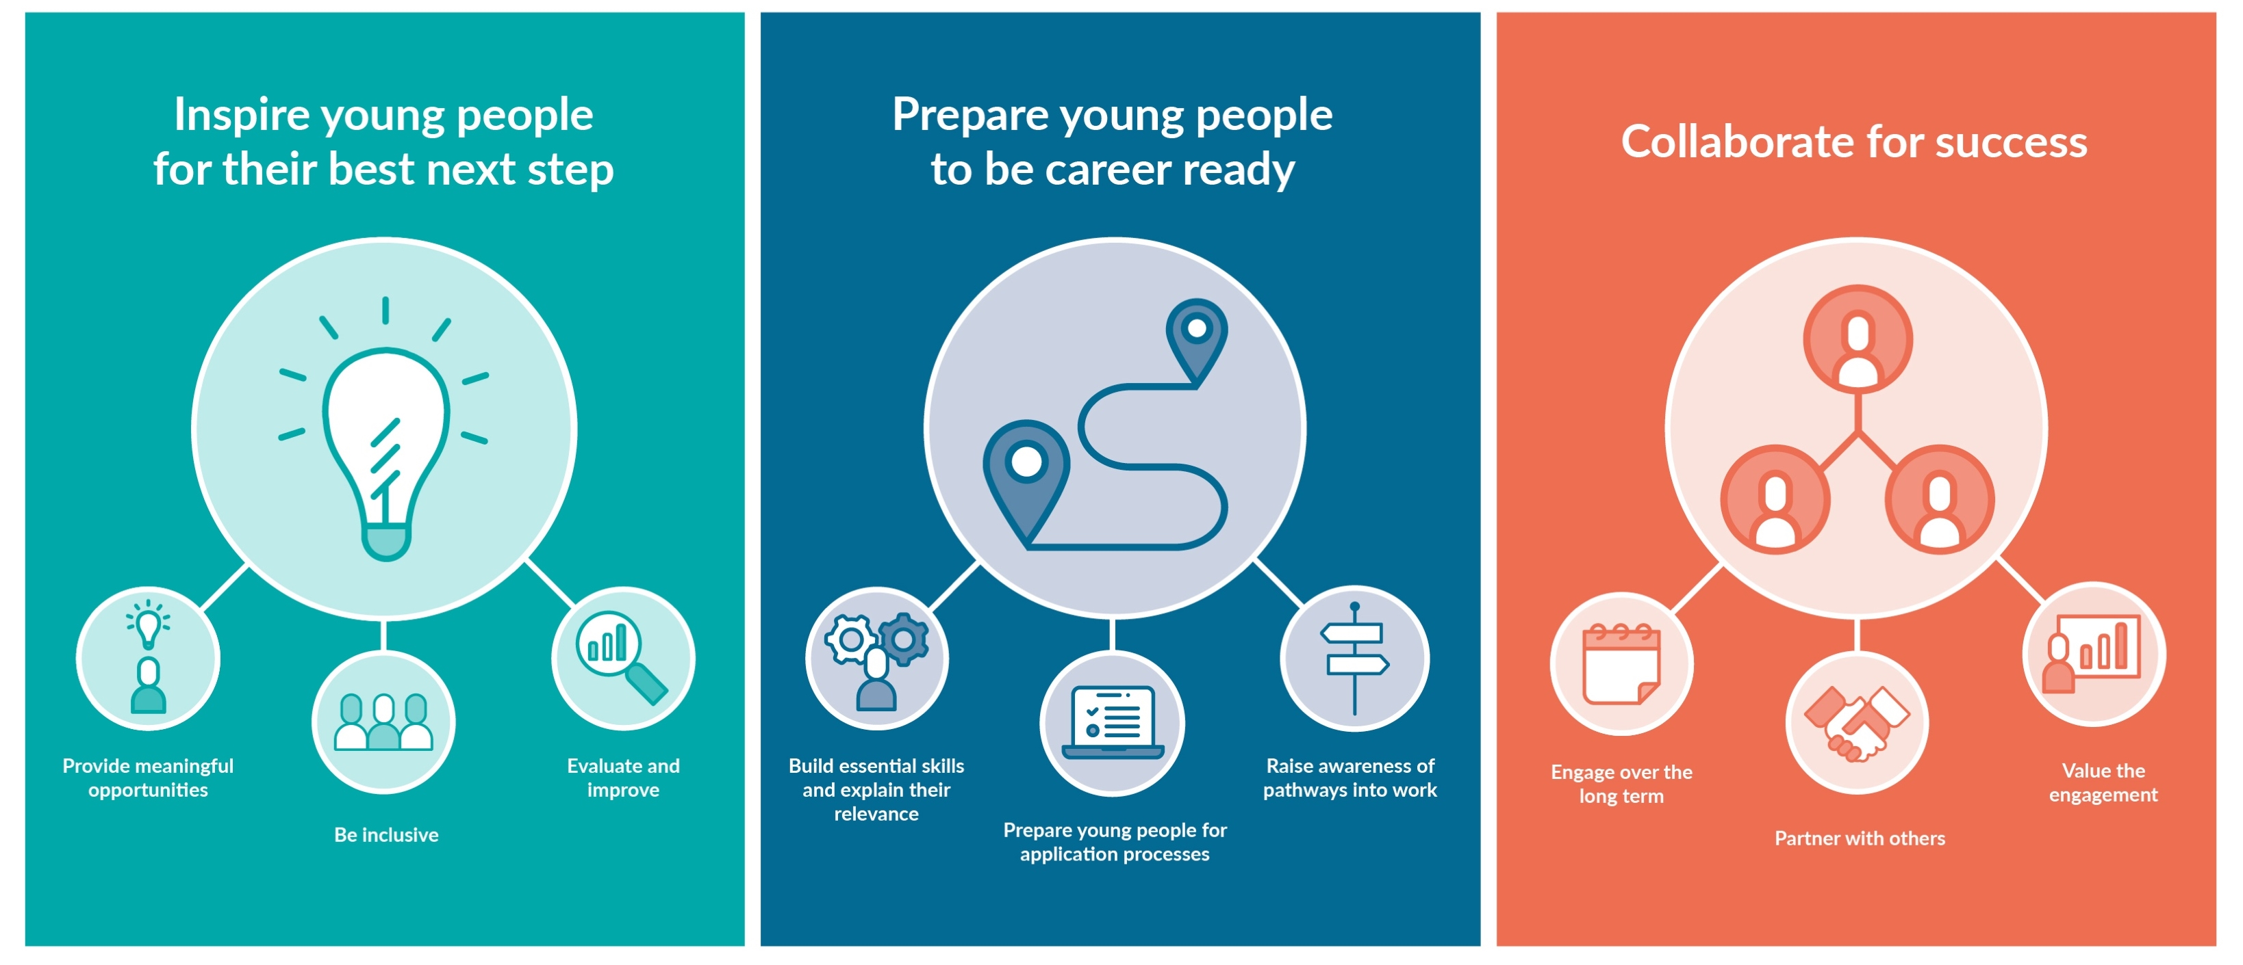

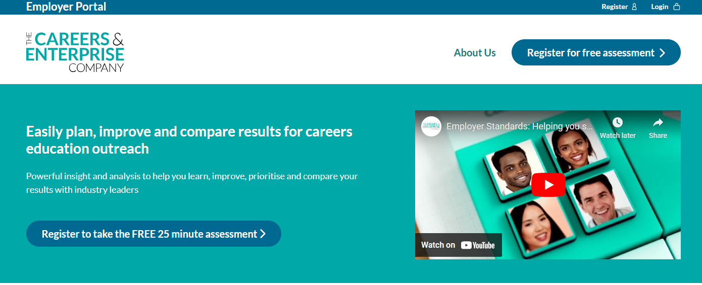
What are the Employer Standards?
A framework that any employer can use, irrespective of their experience in careers education
A FREE online tool, taking only 25mins, for employers who want to evaluate their existing outreach and plan improvements

Slide 33

Who’s used the tool so far? As at 19 January 2026
45% are SME
Largest numbers of users from the following sectors :
Professional, scientific and technical – 259
Manufacturing – 207
Construction – 216
Administrative and support services – 158
Human health and social work – 109
Information and communication – 111
1561
Employers have used the self-assessment tool
99%
planned to improve based on what they learned
97%
found the resources useful or very useful.

Slide 34
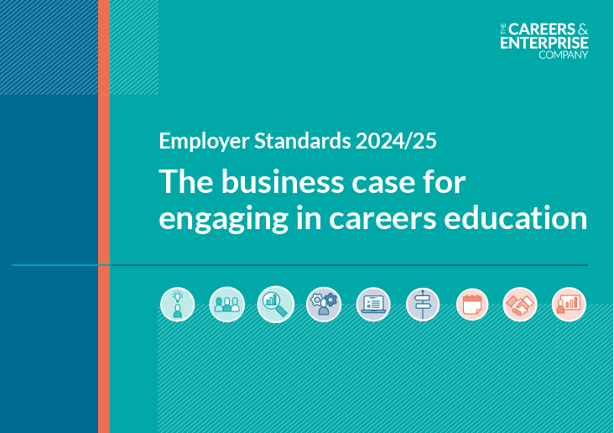
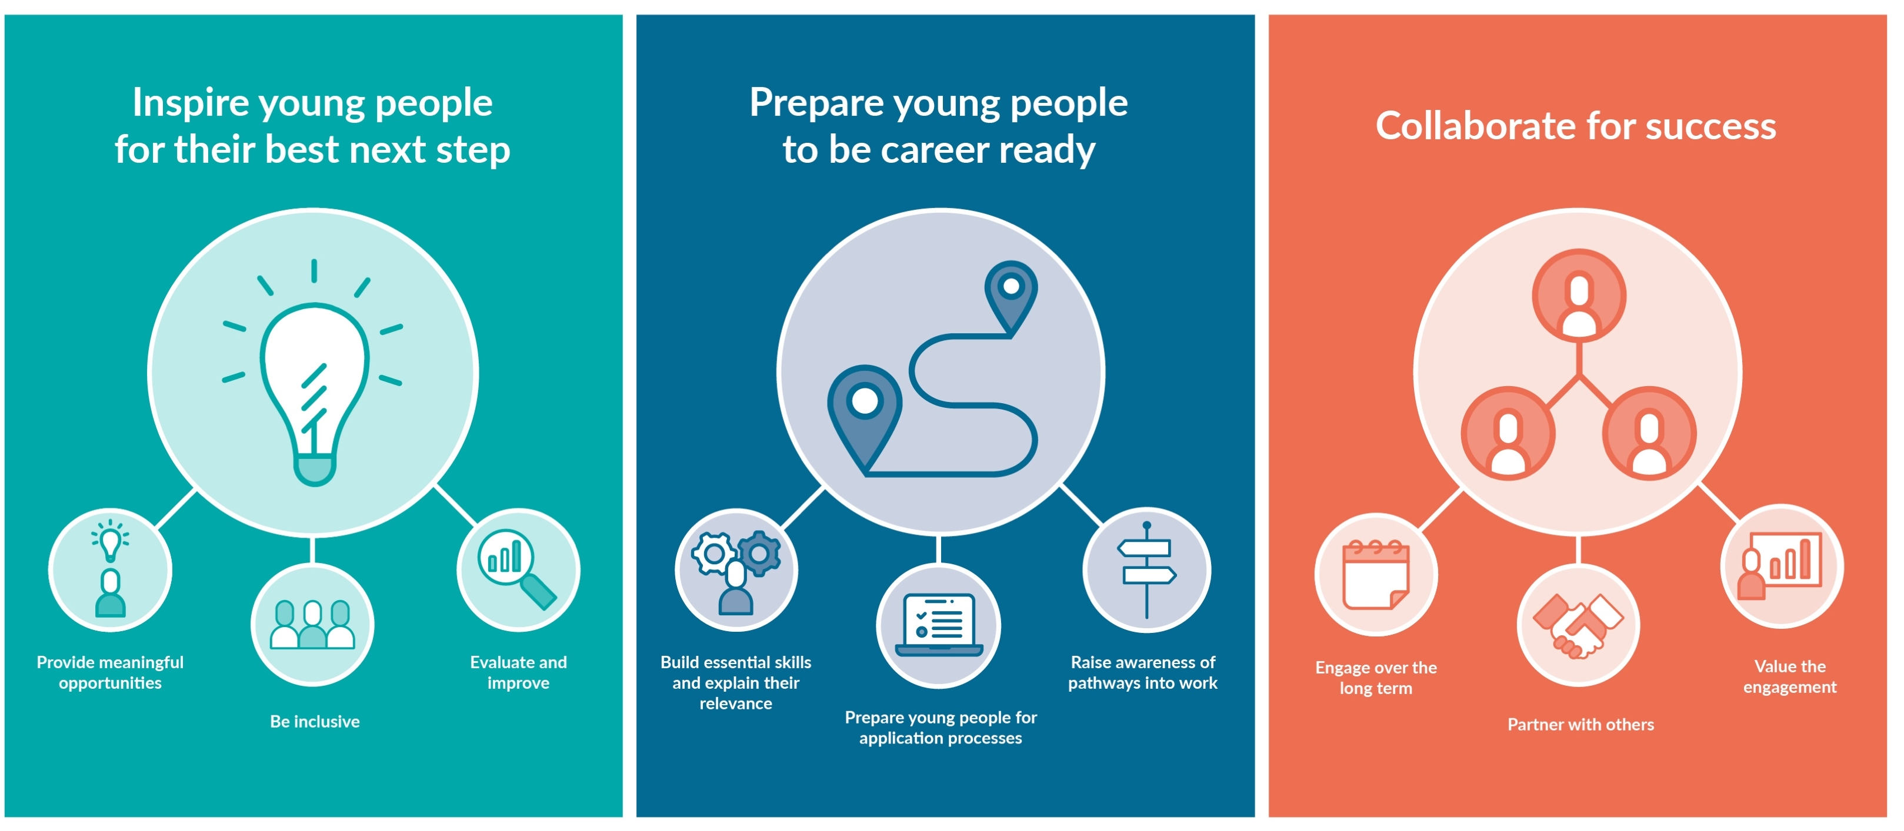
This year’s report
“I was lucky to have an extremely high standard of careers education - one of the main reasons I have made it into a highly competitive apprenticeship, in a career that I love.
This opened my eyes to a large variety of career options and next steps.
Prior to that careers support, I often misbehaved and fell behind in lessons. However, having constant interactions with potential employers within the industry allowed me to visualise what I was working for and to stay motivated with my learning.”

Slide 35
Insight 1
Engaging in careers education positively impacts recruitment, workforce diversity and talent pipelines
Insight 2
Focusing outreach on building essential skills is a cost effective way of developing future talent
Insight 3
Adopting a strategic approach leads to scale and impact

Slide 36
Practical leadership actions and tools to support best practice

Slide 37









Vision
Ambition ALL learners access high quality work experiences
Action
Make progress towards Benchmark 6
Review
Complete an internal leadership review
Achieve
equalex outcomes for ALL young people increasing employability skills and supporting wider benchmark achievement
Deliver
Equitable work experience model
Goal
ALL learners access 5 days across KS3 and 5 days across KS4
Plan
Plan activity to address gaps using equalex and Benchmark 6 meaningful definition
Meet
The Government's work experience guarantee
Identify
Map where learners currently have access across curriculum to work experiences and identify gaps

Slide 38
Supporting Education Leaders to Plan, deliver, and sustain a high-quality work experience programme
Use Statutory Guidance to understand the government’s vision and expectations for 10 days worth of work experience and align school-wide strategy accordingly.
Use Gatsby Benchmark 6 to define meaningful and ensure quality when planning and delivering each workplace experience.
Use the Careers Impact System to evaluate effectiveness and inform continuous improvement aligned with whole school priorities.
Use equalex to define learning outcomes and embed 10 days worth of work experience within a structured delivery framework which is equitable and impactful for all learners from Years 7-11

Slide 39

In-person matters:
Government vision is rooted in young people “going to work” and wherever possible this should mean in-person experiences and placements
Make it meaningful:
All workplace experiences must meet meaningful definition as outlined in Benchmark 6 to be a valid part of the 10-day guarantee (including where virtual experiences are part of the programme)
Benchmark definitions:
BM5&6 remain separate , have separate purposes and have their own definitions of meaningful
Build progressive programmes:
A progressive programme of work experience is underpinned by good quality learning outcomes and will involve more than the stand-alone experiences which make up the guarantee
Role of virtual: add value, don’t replace:
High quality virtual products may have a valuable place in the “whole programme” for example in planning phases or building further awareness/understanding before and after experiences take place
Some key principles to support the modern work experience guarantee

Slide 40
How the CEC can help

Slide 41
Support and resources
Now
Benchmark Toolkits linked to Statutory Guidance
(on Resource Directory)
Building meaningful experiences into progressive careers programmes
Meaningful opportunities guide for employers (accessed via Employer Standards)
A set of FAQs (these will be added to each month)
Live updates to Careers & Enterprise Academy
Full set of exemplar learning outcomes (for a whole careers programme, and equalex outcomes education tested and ready for modern work experience
National modern work experience webinar – watch out for the recording
Coming soon
Delivery models developed and tested by multi academy trusts
Curriculum audit tool
RONI tool
Case studies and examples
CPD for Careers Leaders through The Careers & Enterprise Academy
Excellence Seminars for employers & educators
Let’s make it work: The Podcast – a new podcast series decoding policy, spotlighting practise and equipping stakeholders for success – with multi stakeholder content

Slide 42
National Webinar Recording
Modern work experience FAQs modern-work-experience-guarantee-faqs-aug-2025-update.pdf
A national broadcast | Modern Work Experience: Let’s Make It Work.
Let’s make it work: The Podcast

Slide 43
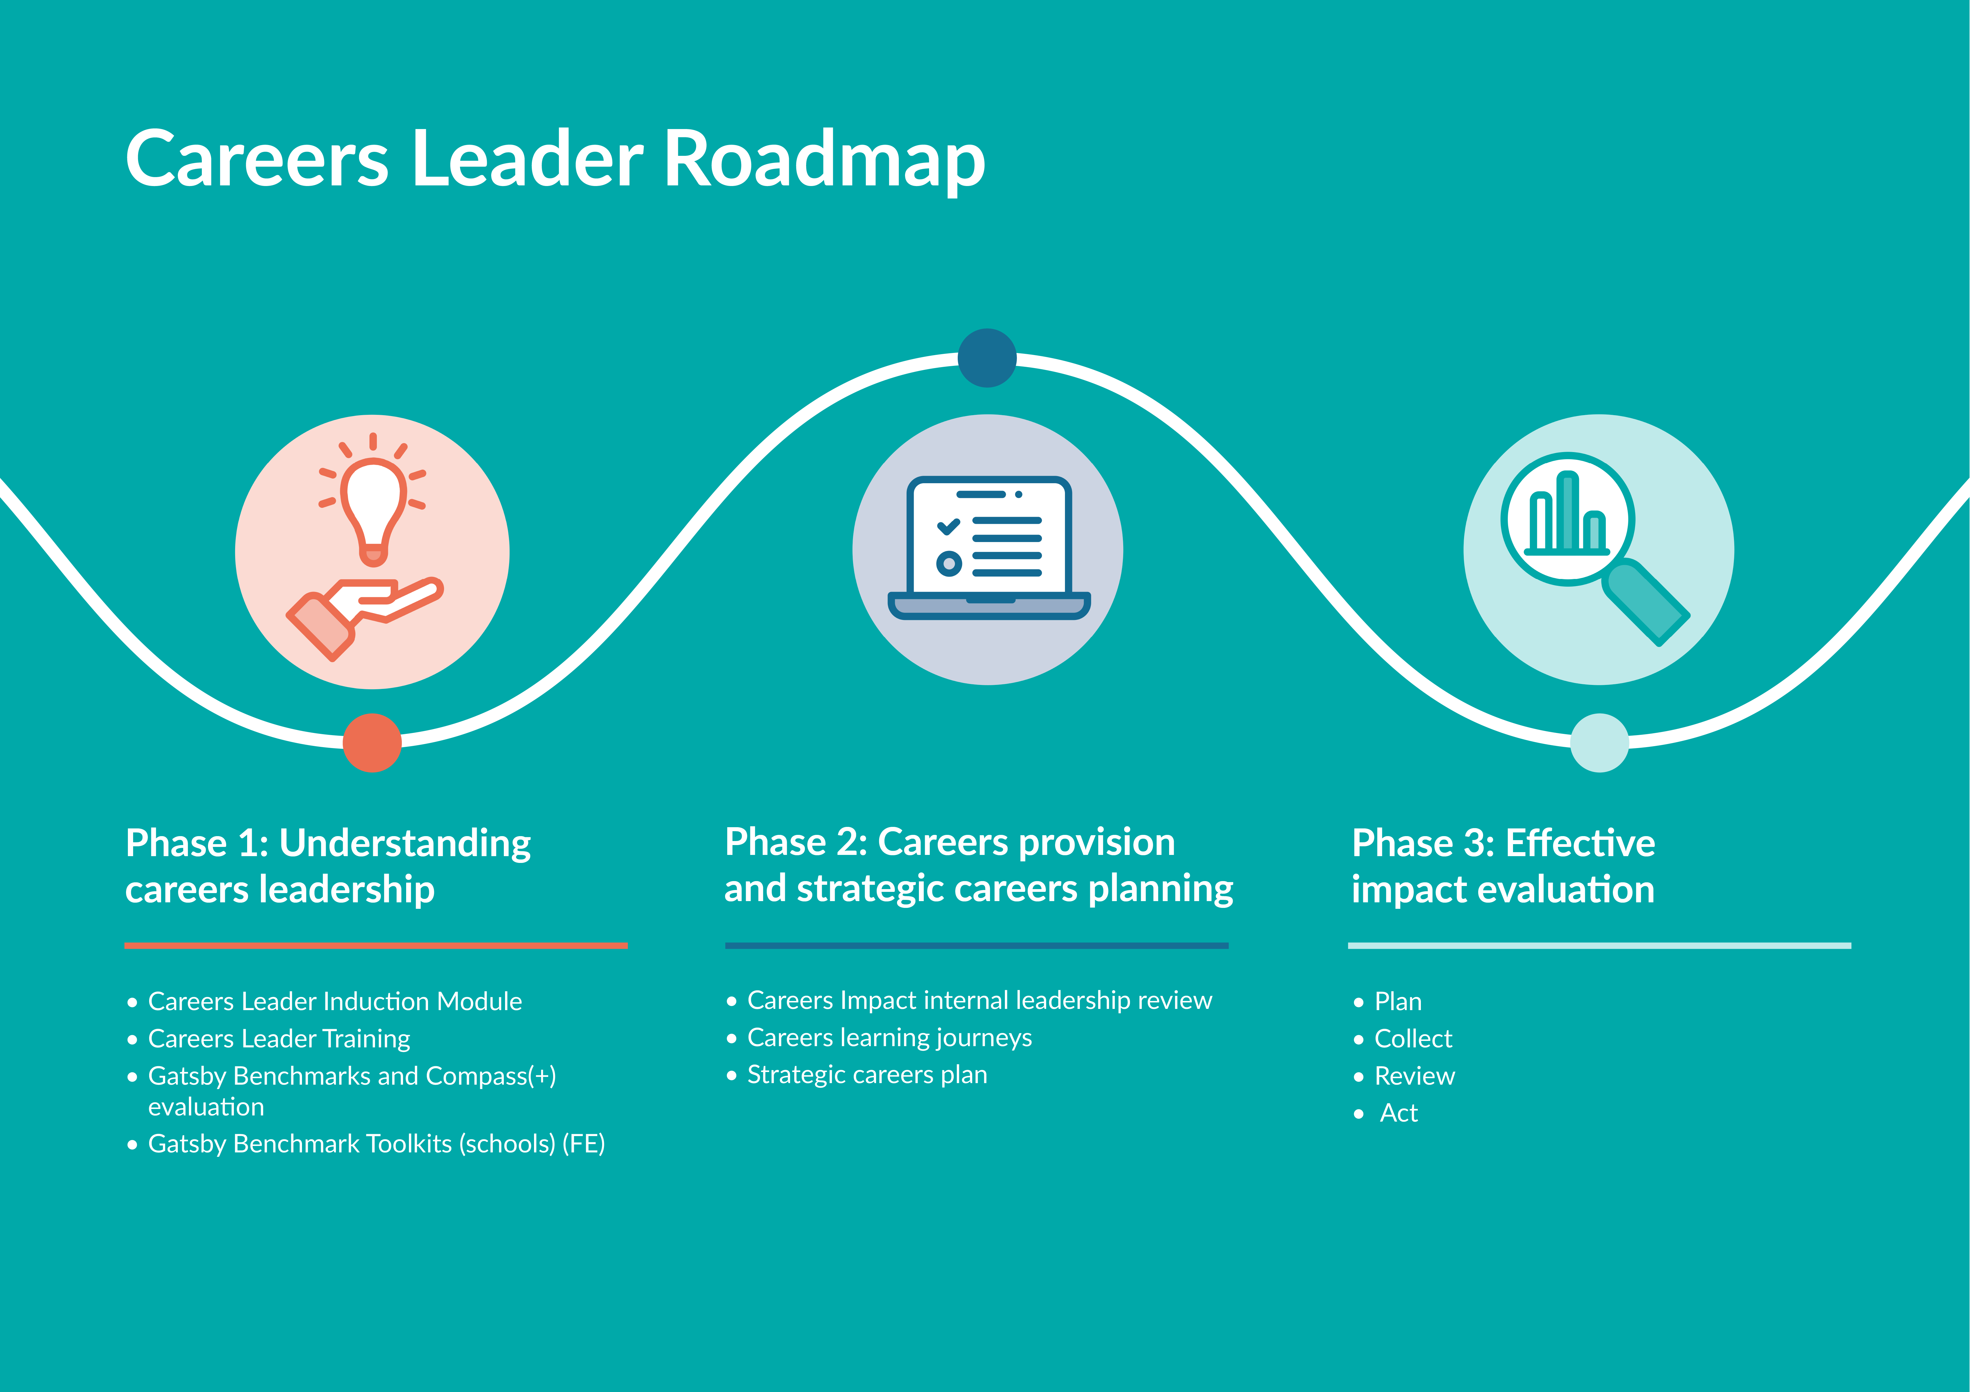
Embedding sustainable and strategic careers leadership

Slide 44
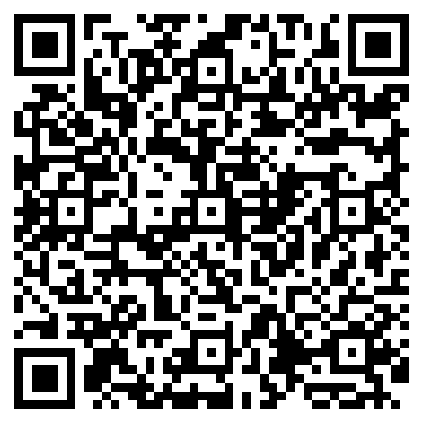
My Learning, My Future
Compass Evaluation: Question-by-question guidance
Gatsby Benchmark: Updated Toolkits (Schools and FE)
Careers Leader Roadmap
Understanding how to create a strategic careers plan
Understanding how to develop progressive and responsive careers provision (Student Careers Learning Journey)
Understanding how to effectively evaluate your careers provision
Understanding how to embed careers in the curriculum
Understanding how to embed progressive employer encounters and work experiences
Understanding how to embed progressive encounters with further and higher education
Careers Statutory Guidance: At a glance guides for school, college and ITP leaders
Understanding the role of the Careers Leader: A Guide for Secondary Schools
Careers Education: A Guide for secondary and special school governors
Benchmark 1: Suggested universal career-related learning outcomes
Careers as a Driver for Whole-Institution Improvement: A Guide for Education Leaders in schools and colleges
Education Inspection Framework Guide for Careers Leaders and Education Leaders

Slide 45

How to Guides
Understanding how to…
Create a strategic careers plan
Develop progressive and responsive careers provision
Effectively evaluate your careers provision
Embed careers in the curriculum
Embed progressive employer encounters and work experiences
Embed progressive encounters with further and higher education

Slide 46

Education Leader Suite
Careers as a driver for whole institution improvement: A guide for Education leaders in schools and colleges
Education Inspection Framework (Ofsted): A guide for Careers Leaders and Education Leaders
Understanding the role of Careers Leader (Schools & Colleges with ITPs coming soon)
Driving equity and tackling disadvantage through your careers provision: Educator Guide

Slide 47




Primary Career-related Learning
In October 2025, The Careers & Enterprise Company (CEC) launched the findings from its DfE-backed primary pilot, Start Small; Dream Big.
The pilot demonstrated the powerful impact of early careers learning when primary schools are supported effectively by Careers Hubs and given access to CPD:
⭐ 81% of teachers reported their senior leadership team was actively engaged in supporting career learning.​
​
⭐ Three-quarters of teachers (75%) observed that by the end of the pilot fewer pupils felt limited by gender stereotypes in their career dreams.​
​
⭐ 93% of participating employers said they are committed to continuing to engage with local primary schools beyond the pilot.
Building on this success, the pilot CPD is now available nationally, enabling every primary educator to champion early careers learning in their school.

Slide 48
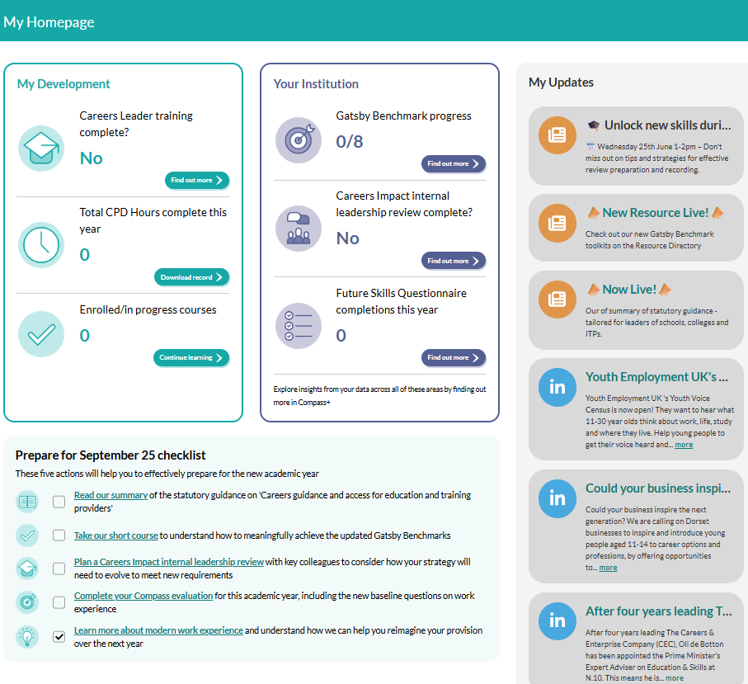
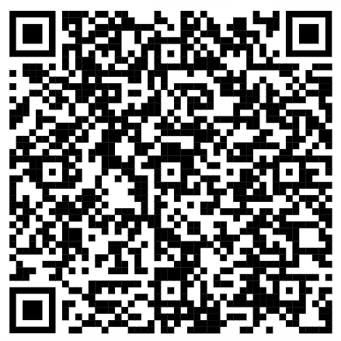
The Careers & Enterprise Academy
Our new digital platform is for Career Leaders and all those who work with them to plan and deliver strategic, progressive career programmes.
For Careers Leaders, bespoke learning content is available to build foundational knowledge, then develop deeper skills including learning how to effectively engage parents/carers and using our digital tools to drive impact. To support the release of updated Statutory Guidance, the site also includes a new homepage exclusively for Careers Leaders with a data and learning dashboard, a checklist highlighting all the steps needed to prepare for September 2025 and a handy newsfeed alerting users to new content and events
For Education Leaders, Governors, SENCOs or the wider teaching workforce, tailored content is available to help everyone effectively play their part in helping young people find their best next step
For all users, there are 15 courses available, including all those for educators previously on the Digital Hub, plus NEW courses:
  Understanding the updates to the Gatsby Benchmarks
  Understanding the Careers Impact internal leadership review
  Preparing for meaningful achievement of the updated Gatsby Benchmarks

Slide 49
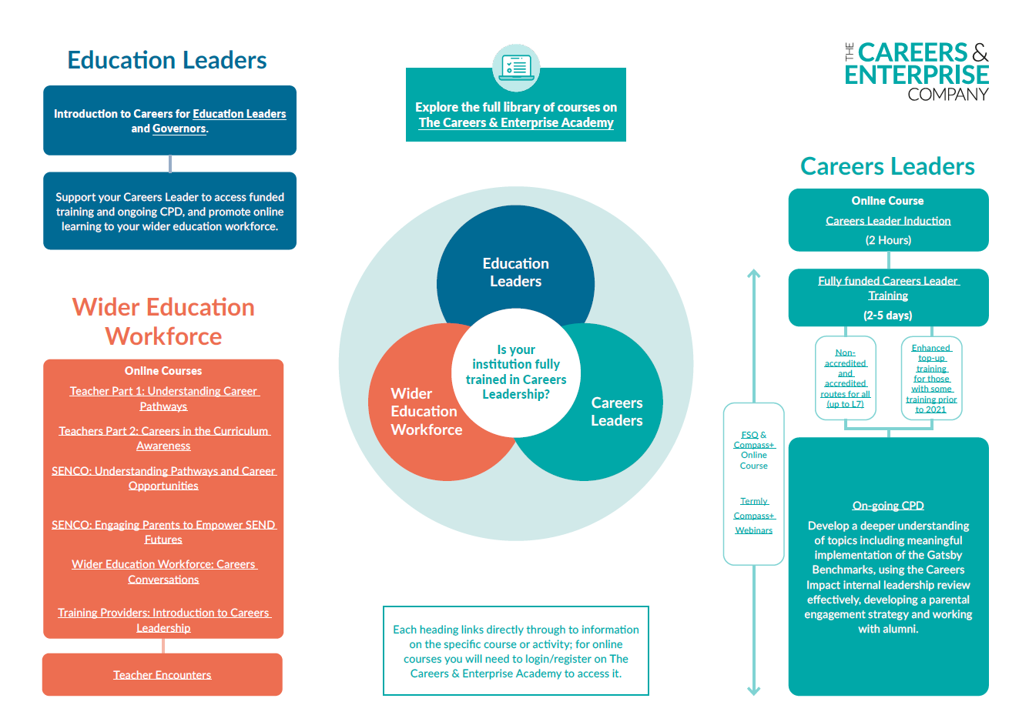
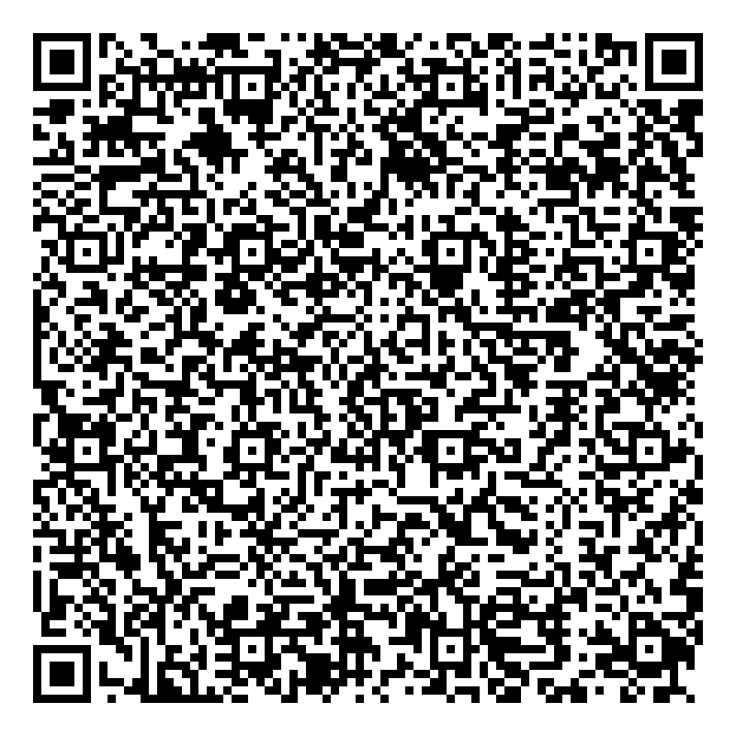

Slide 50
Thank you
education@careersandenterprise.co.uk

