Slide 1


Economic Transformation & Drivers, Future Skills & Growth
Gloucestershire Careers Leadership
Matt Tudge, Head of Skills (& manager of Chamber teams)

Slide 2
We help companies grow, innovate and export.
Everything we do contributes to making the South-West the best place to live, learn and work.
Business West.
Delivering for our businesses of tomorrow, today.

Slide 3
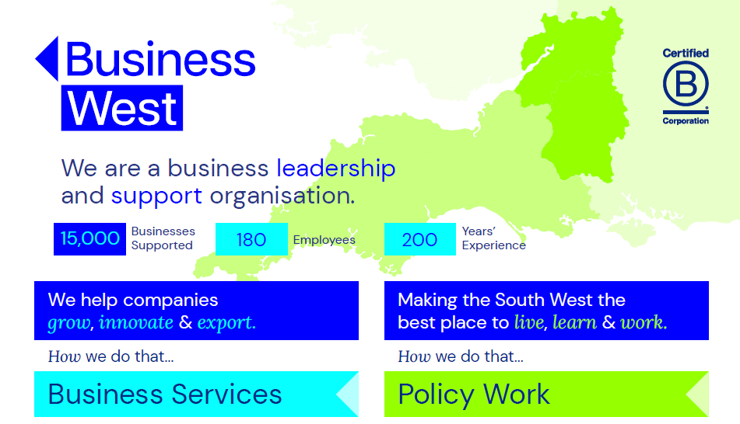




Slide 4
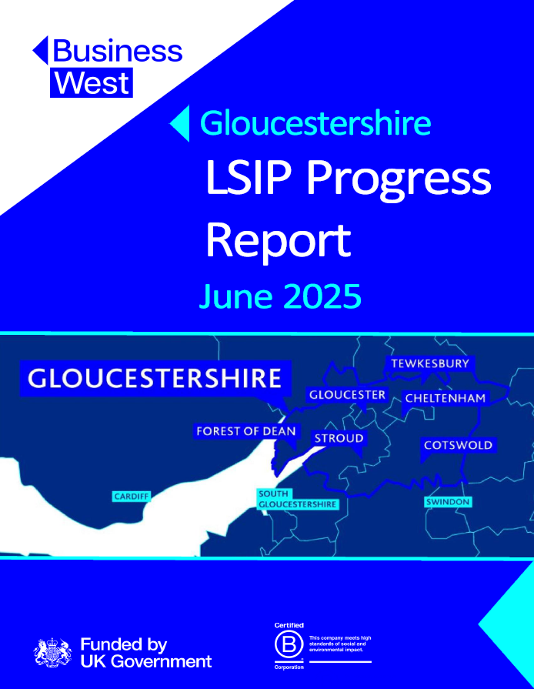
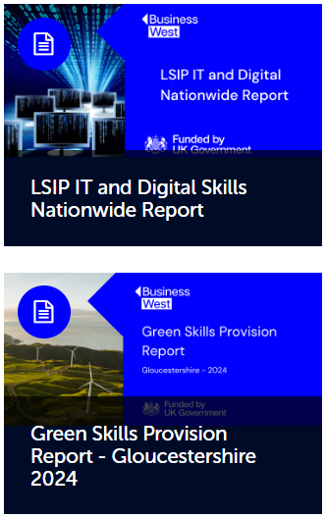
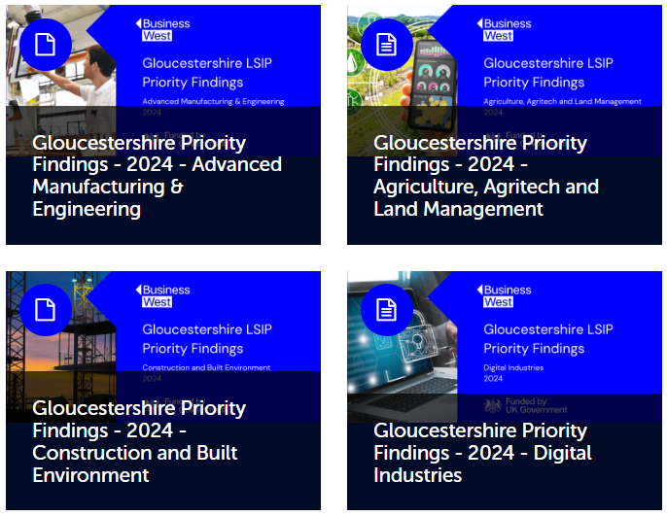

Slide 5
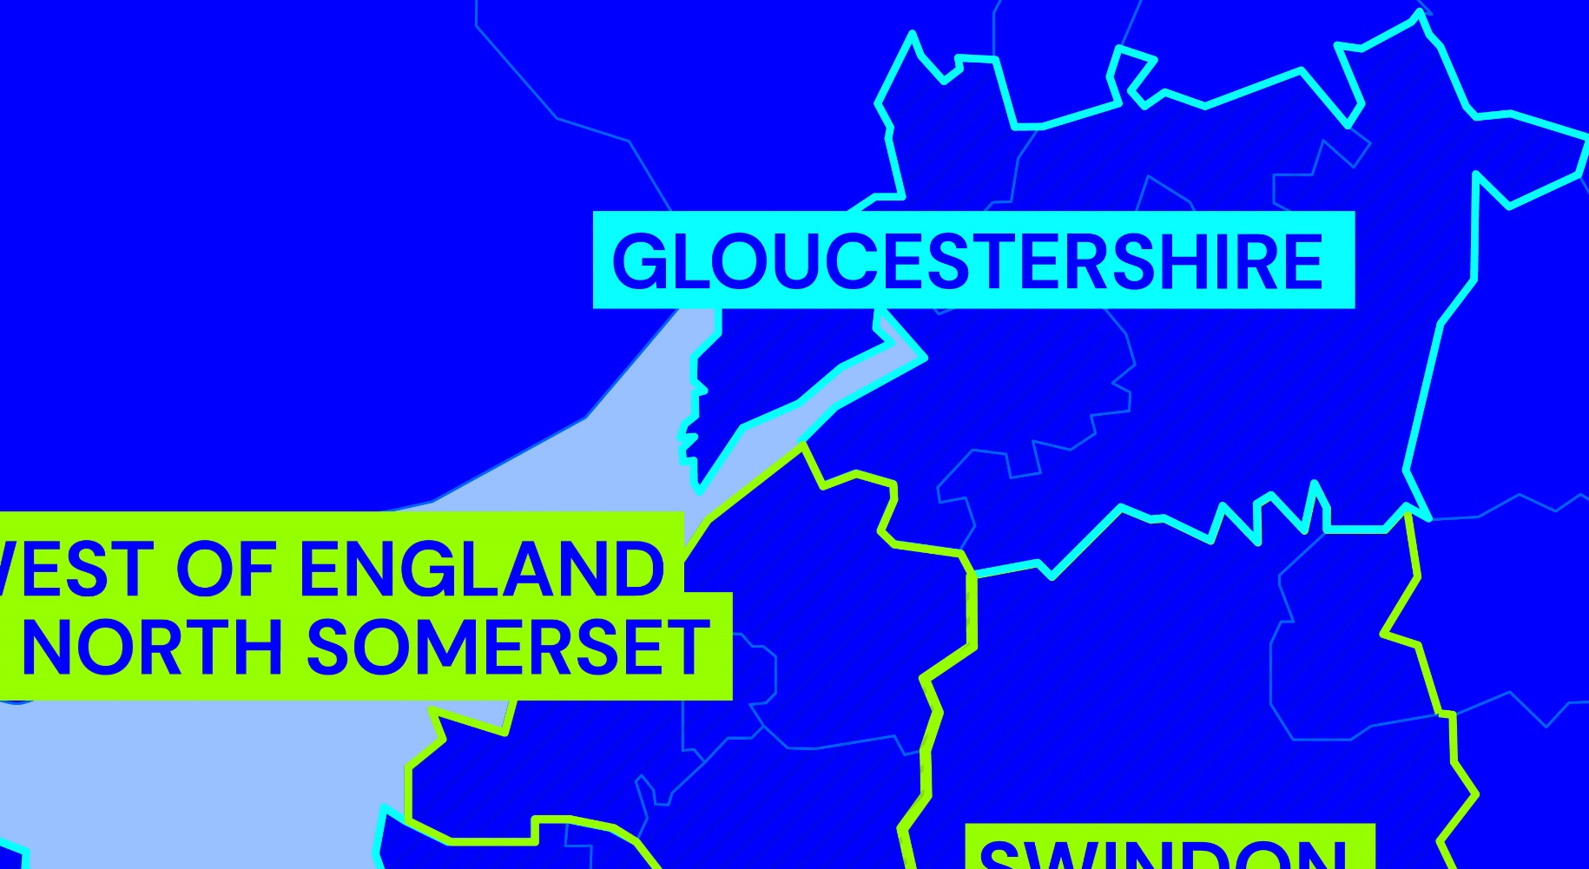

Gloucestershire LSIP 2025-2028
Sectors in the Local Growth Plan 2025
Security, Cyber and Digital Technologies
Agri-Tech
Advanced Manufacturing and Engineering
Green Energy Generation
LSIP to also include:
Creative Industries, Culture & Sustainable Tourism

Slide 6
  Critical & Enabling - Preparedness:
  Understanding the nature of and being ready for work
  Critical and enabling skills that allow business to be done
  Adaptability, readiness and understanding of work
  Broaden aspiration in line with employment opportunity (brain drain)
  Replacing the ‘paper round’
  “young people need more exposure to work”
  Technical and sectoral
  Transformative: Changing needs and roles in line with the fourth industrial revolution

Slide 7
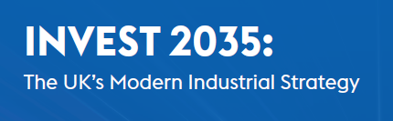
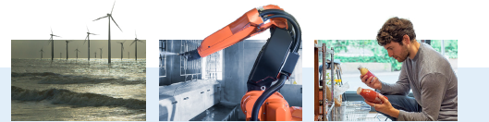
The UK bets big on the universal need for digital
“Diffusing the latest technology across our economy and public services will be as important as supporting the latest unicorns.”
“I will introduce a curriculum fit for the digital age”
Keir Starmer speeches, 2023, London Tech Week and review of National Curriculum
‘Unleash AI’
Plans to increase digital inclusion
Third country in the world to have a tech sector valued at over $1 trillion
Industrial Strategy - one of three ‘critical opportunities’
Industrial Strategy - one of the eight identified priority growth sectors

Slide 8
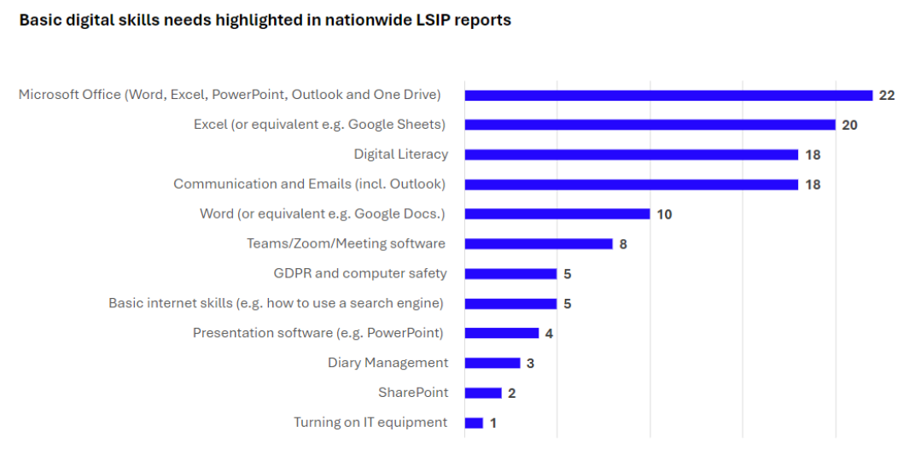

Slide 9
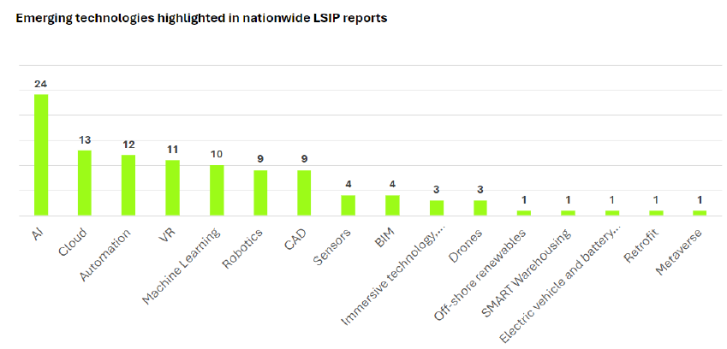

Slide 10
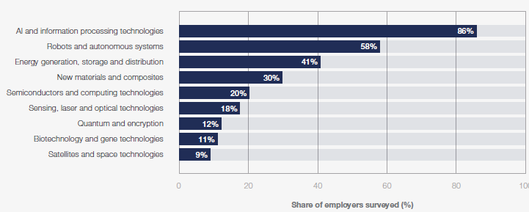
Digital Skills are universally required
Technology Trends Driving Business Transformation
Future of Jobs Survey 2025, World Economic Forum
https://reports.weforum.org/docs/WEF_Future_of_Jobs_Report_2025.pdf

Slide 11
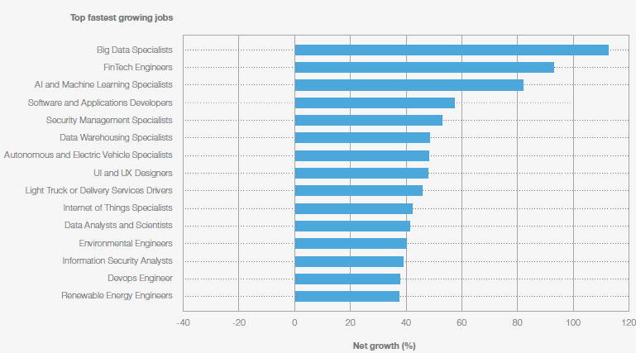

Slide 12
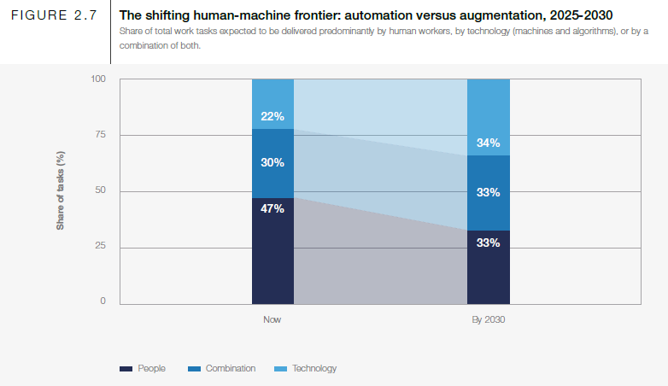
Skills and Change, technology and critical human needs
World Economic Forum Future of Jobs Survey 2023

Slide 13
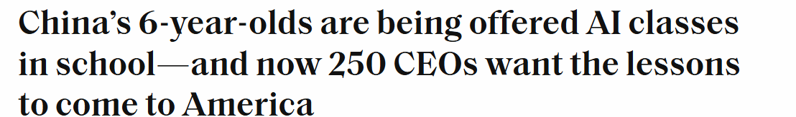

Steve Bannon - AI ‘job-killing’, which gets virtually no attention now, will be a major issue in the 2028 presidential campaign."I don't think anyone is taking into consideration how administrative, managerial and tech jobs for people under 30 - entry-level jobs that are so important in your 20s - are going to be eviscerated,"
CEO of Anthropic AI : AI could wipe out half of all entry-level white-collar jobs — and spike unemployment to 10-20% in the next one to five years.
There is this whole spectrum of crazy futures. But the one that I feel we’re almost guaranteed to get […] is where, at the very least, you get a drop in white collar workers at some point in the next five years,”
WEF – AI expected to create 170m and displace 92m jobs globally
IMF – almost 40% of global employment is exposed to AI

Slide 14
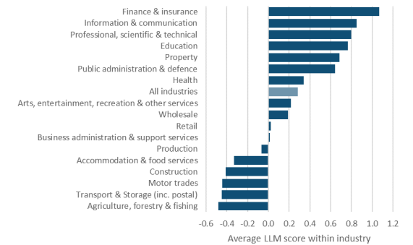
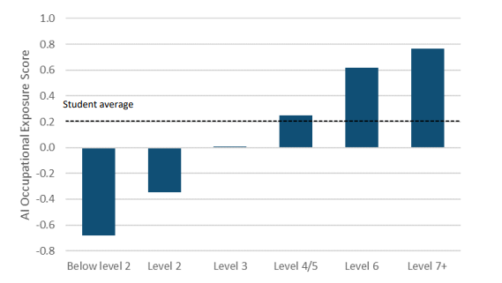
Employees with more advanced qualifications are typically in jobs more exposed to AI. For example, employees with a level 6 qualification are more likely to work in a job with higher exposure to AI than employees with a level 3 qualification
B&NES Exposure
The finance and insurance sector is more exposed to AI than any other sector. The other sectors most exposed to AI are information & communication, professional, scientific and technical, property, public admin & defence, and education

Slide 15
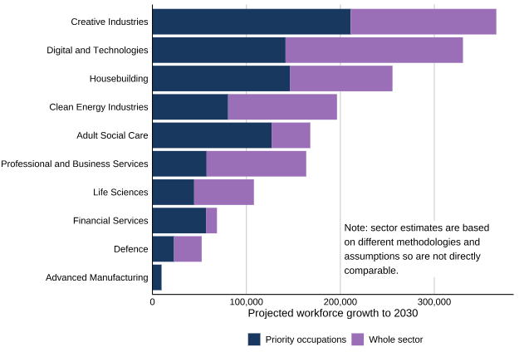
Assessment of Priority Skills to 2030,
Skills England planning scenarios based on sector-level projections, November 2025

Slide 16
We all want:
Opportunity for residents - clear pathways into meaningful work
Opportunity for businesses - the right skills, at the right time
Alignment with growth - careers linked to real economic demand
What will make the difference
Work through & with employer bodies - Chambers of Commerce and trusted business networks
Tell us what you need from business (via Vicky and the team) — we’ll help strengthen and sustain those relationships
Give employers clarity and time - a clear return on investment and a ladder of ways to engage
Recognise the shift - employment is changing
Align careers with economic growth priorities and future potential
Collaboration in action - Joint solutions that make it easier for learners, employers and partners to get what they need, simply and effectively

